Slide 1

Connecting to a Network
Lesson 5

Slide 2
Objectives
Understand the OSI Reference Model and its relationship to Windows 7 networking
Install and configure networking components
Use the Network and Sharing Center
Configure TCP/IP manually and automatically
Use TCP/IP tools to troubleshoot network connectivity problems
Notes:
Outline the material you are going to cover in this lesson. Do not go into detail as each of these points will be expanded on in the lesson. You may also want to mention the Technology Skills that are being covered for the Certification exam also.

Slide 3
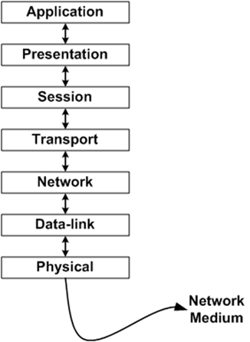
OSI Reference Model
ie, Chrome, Outlook, Firefox etc, user interface level
The layer the operating system works on, device drivers
Creates a session between your computer and
the computer you are trying to get information from
Controls how much information you send to the
other computer and how much you need to get back
The layer that routers operate at, your IP address
is at this layer, DNS, default gateways, subnet masks
The layer where switches operate, MAC addresses
Address resolution
All physical pieces that connects the computers,
panels, cables etc
Ref - The OSI Model Demystified - http://www.youtube.com/watch?v=HEEnLZV2wGI
Notes:
Depending on your students’ background and the purpose of your course, you may want to spend time on the OSI Reference Model to help define networking before talking about networking with Windows 7. There is extensive information in the textbook to allow you to go into a lot or a little detail of the OSI Reference Model.

Slide 4
Installing Network Support
Default networking components installed:
  Client for Microsoft Networks
  QoS Packet Scheduler
  File and Printer Sharing for Microsoft Networks
  Internet Protocol Version 6 (TCP/IPv6)
  Internet Protocol Version 4 (TCP/IPv4)
  Link Layer Topology Discovery I/O Driver and Link Layer Topology Discovery Responder
Notes:
Describe how Windows 7 will automatically install the above components when a network interface adapter is detected on the computer during installation. Describe the purpose of each component.

Slide 5
Network Locations
Home Not directly connected to net, safe to share files and discover other computers on same network
Work connected to small office workgroup
Public connected in place such as airport, hot spot, the computer and it’s shares are protected
Domain connected to active domain directory service
Notes:
Network locations are combinations of network discovery and file sharing settings which determine how much access the workstation user will have to the network and how much access network users will have to the workstation. Describe each of the settings and when you would use each one.

Slide 6
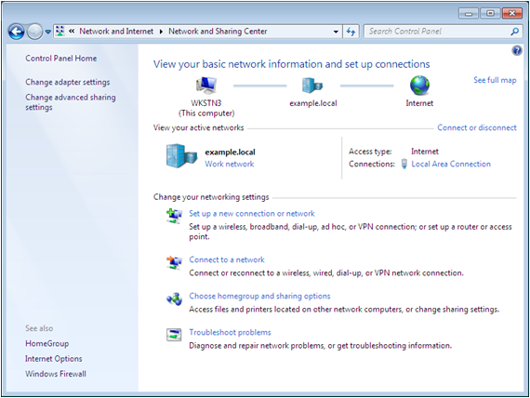




Using the Network and Sharing Center
Summary
Network Map
Task List
View Your
Active Networks
Change Your
Networking Settings
Notes:
Describe the elements of the Network and Sharing Center

Slide 7
Understanding Network Discovery
Controls Windows Firewall settings
A firewall is a barrier between the computer and the network that allows certain types of traffic through, and blocks other traffic.
Firewalls filter using TCP/IP characteristics:
  IP addresses
  Protocol numbers
  Port numbers (p159 table 5-3)
Notes:
Explain that this feature was introduced in Windows Vista. It is a simple way for non-technical users to change firewall settings by selecting simple configuration options. You need to understand how a firewall works in order to understand what Network Discovery is doing for you. Describe the purpose of a Firewall and that its configuration can be extremely complex.

Slide 8
Network Discovery Settings
ON or OFF – Controls two functions:
Whether the computer can see and be seen by the other systems on the network
Whether the computer can share its resources and access shared resources on the network
Notes:
Expand on what happens when Network Discovery is turned ON or OFF on a Windows 7 computer.

Slide 9
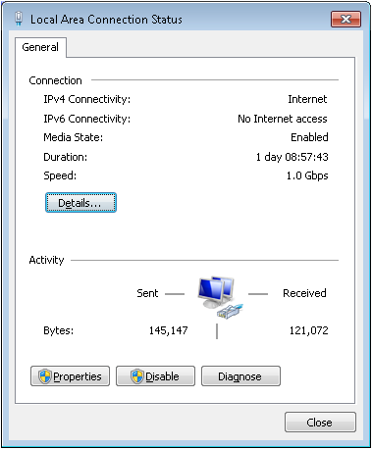
Viewing a Connection’s Status
Notes:
Each local area connection on a Windows 7 system has a status dialog box that displays real time information about the connection. Using the screen shot, describe the different pieces of information displayed and what it means, or demonstrate.

Slide 10
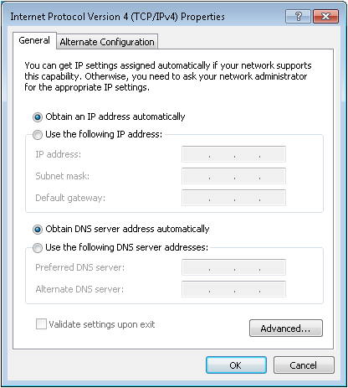
Configuring IPv4 Settings
Notes:
Explain or demonstrate how to get to this dialog box. Show the different settings for Automatic and Manual configuration, which will be explained on the next couple of slides.

Slide 11
Automatic TCP/IP Configuration
Uses DHCP – Dynamic Host Configuration Protocol
Clients request and receive addressing information from DHCP – Can be server or router
Notes:
Explain how a client gets an address from the DHCP server. Discuss how different devices can be the DHCP server.

Slide 12
Manual TCP/IP Configuration
Manually enter information into all fields in the TCP/IP Properties dialog box
Depending on whether you are connected to other networks, you do not have to fill out all fields
Minimum requirements:
  IP Address
  Subnet Mask
Notes:
Discuss under which situations you might need to manually configure your TCP/IP information and discuss the drawbacks of manual configuration. The specific fields of the dialog box are discussed on the next slides.

Slide 13
IPv4 Addressing
IP Address — Four sets of numbers between 0 and 255 separated by a dot. Each address is unique worldwide.
Subnet Mask — Used for network and host identification.
Network identifier Host identifier
Example: IP Address 142.204.34.136
Subnet Mask 255.255. 0. 0
Notes:
Briefly explain IP addressing and what an IP address is used for and what the Subnet Mask is used for. Explain why the IP addresses and Subnet masks only contain numbers between 0-255 and what the Network portion of the address is and the host identifier portion. There is a substantial amount of TCP/IP information at the beginning of the chapter. You can explain as much or as little as needed depending on students’ background and course requirements.

Slide 14
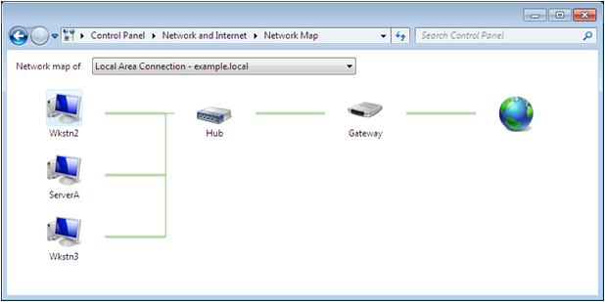
Network Map
Displays a graphical map of the computers on the network and the connection between them
Notes:
Network Map is an administration and diagnostics tool that displays a graphical map of the computers on the network and the connections between them
Network Map is a tool that first appeared in Windows Vista, and is now included in all of the Windows operating systems. Network Map automatically compiles a graphical representation of the network, including icons representing the computers, printers, and other devices attached to it, and lines representing the connections between these elements.
Network Map uses a protocol called Link Layer Topology Discovery (LLTD) to discover information about the network and the devices attached to it. LLTD devices called enumerators transmit requests for information over the network, and other computers, called responders, reply with the requested information. This protocol not only enables the computer to discover the existence of other systems on the network, it also tests the connections between them.

Slide 15
Displaying a Network Map
Network Discovery must be turned on.
If the computer is a member of a Windows domain, group policy must be configured to permit network mapping.
Notes:
The Network and Sharing Center displays a summary map on its main window, but to display a complete map of the network, you must click the See full map link.
From a security standpoint, it is not a good idea to allow just anyone to access a map of your network. As a result, when a Windows 7 computer is a member of a Windows domain, network mapping is disabled by the default group policy settings. To control network mapping with group policy, you must use the Group Policy Management Console

Slide 16
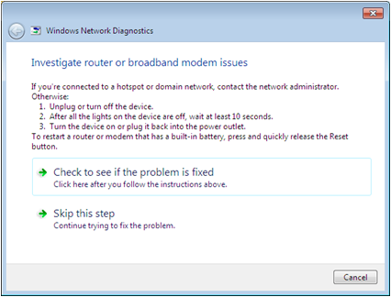
Running Network Diagnostics
Click on warning icon on network map and Windows Network Diagnostics launches
Attempts to discover the cause of the problem and offers possible solutions
Notes:
The Network Map displays shows not only the existence of the devices on the network, but their status, and that of the connections between them. Improperly configured computers have yellow warning signs on their icons and non-functioning connections have red X’s on them.
When a problem exists, clicking a warning icon launches Windows Network diagnostics. This utility attempts to automatically discover the cause of the problem and displays possible solutions.

Slide 17
Windows Network Diagnostics
Problems that can be diagnosed:
  Broken or detached cable connections
  IP Address and Subnet Mask problems
  Default gateway problems
  DNS and DHCP configuration problems
  Networking hardware configuration problems
  Internet server addresses and service settings
Notes:
Go through the problems that the Windows Network Diagnostic tools can diagnose. Note that the system will try to repair it if you select the link to tell it to do so. It will otherwise display a list of manual fixes that you can perform to address the problem.

Slide 18
Using TCP/IP Tools
Ipconfig.exe
Ping.exe
Tracert.exe
Nslookup.exe
Netstat.exe
Notes:
Introduce each TCP/IP tool. They will be discussed further on the following slides.

Slide 19
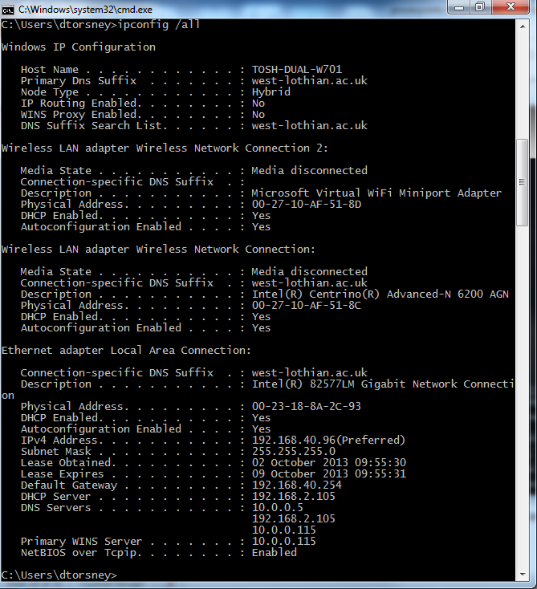
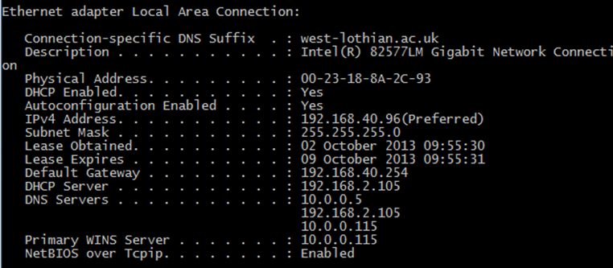
Ipconfig.exe
Ipconfig /all
Ipconfig /release
Ipconfig /renew
Notes:
Outline the purpose of the Ipconfig command and what the different switches do. If you cannot demonstrate, use the screen shot on the slide to help you explain the output of the command.

Slide 20
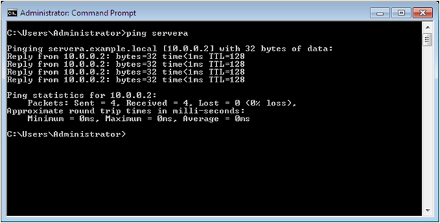
Ping.exe
> Ping target
> Ping ip_address
> Ping computer_name
Try - ping 192.168.40.93
Notes:
Using the description from the textbook, explain the purpose of ping. If you cannot demonstrate, use the screen shot to help you explain what happens when you use the command.

Slide 21
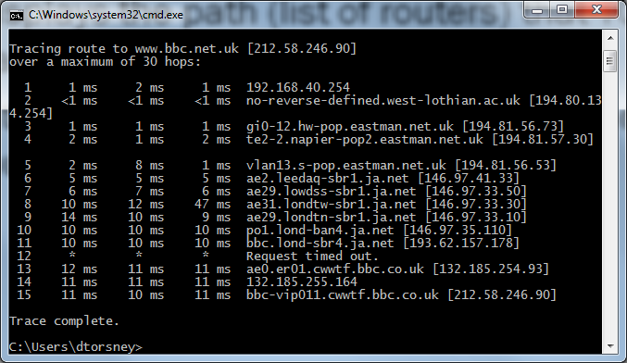
Tracert.exe
Displays the path (list of routers) that TCP/IP packets take to their final destination.
Internet is constantly changing, therefore the route displayed may not be accurate.
Logged in as hccomp, elevated cmd prompt -tracert www.bbc.co.uk
Type the first IP address shown into internet explorer address bar
Notes:
Explain the tracert command. Refer to output in the textbook if you cannot demonstrate.

Slide 22
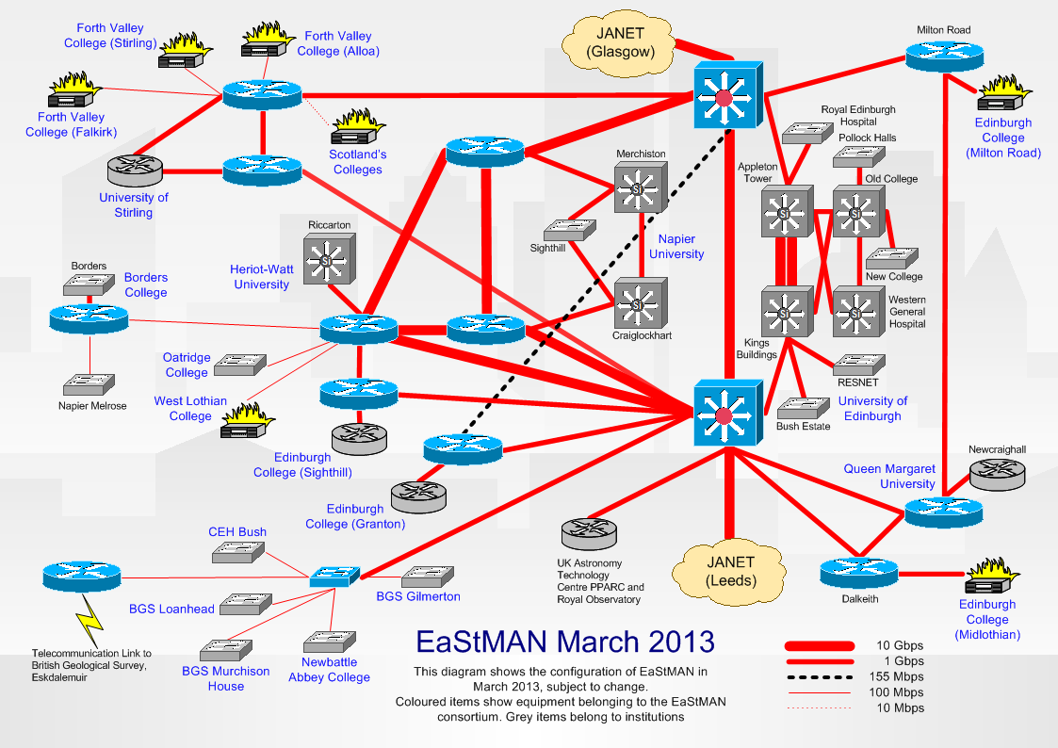
http://www.eastman.net.uk/diagrams.html

Slide 23
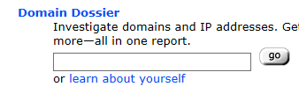
Using browser go to centralops.net
enter college address into Domain Dossier box
copy the IP address given (77.73.4.208)
Go to http://www.yougetsignal.com/tools/visual-tracert/
Try a proxy Trace to www.west-lothian.ac.uk,
try a proxy trace to 194.80.134.254
try some others e.g. 194.61.183.111
at command prompt enter nslookup 194.61.183.111
using a browser enter 194.61.183.111 as the address
try a proxy trace to 77.73.4.208

Slide 24
Test for ipv6 connectivity
Using your browser go to
    http://test-ipv6.com/
    see text book p 155 IPv6 Transition

Slide 25
Tasks
Complete LAB 7
Do Lesson 5 review quiz @ 192.168.40.93
(use book as reference)
Note the Result on lab response sheet
Send LAB 7 Response sheet to dtorsney@west-lothian.ac.uk
Do Knowledge Assessments p 182 (textbook)

